Slide 1



Slide 2
CONTENTS
01 Composition and Characteristics of Magnesium Phosphate Cementitious Material
02 Engineering Applications of Magnesium Phosphate Cementitious Material
03 Magnesium Phosphate Cementitious Material Product Series
04 Application Prospects of Magnesium Phosphate Cementitious Material Product Series

Slide 3
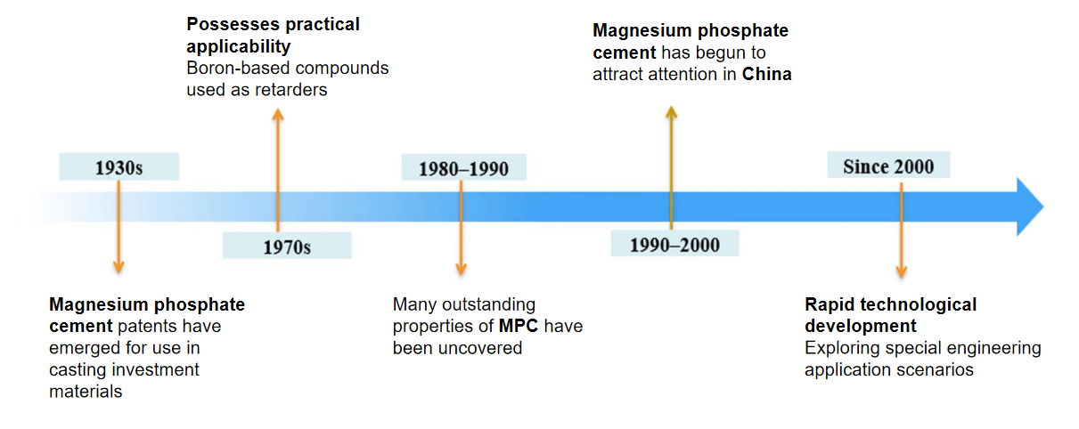
1.Composition and Properties of Magnesium Phosphate Cementitious Materials
Phosphate cement
Chemically bonded phosphate
ceramics
Magnesium phosphate cementitious
material

Slide 4
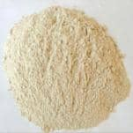
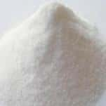
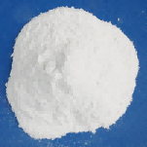

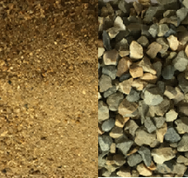
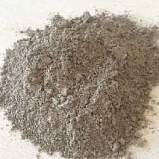
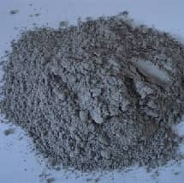
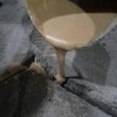
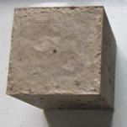
1.Composition and Properties of Magnesium Phosphate Cementitious Materials
Magnesium phosphate cementitious material (also known as magnesium phosphate cement or Magnesium Phosphate Cement, MPC) is a hydraulic inorganic cementitious material that rapidly sets and hardens upon mixing with water. It is prepared by proportionally blending calcined magnesium oxide, soluble phosphates, retarders, and auxiliary components.
Basic cementitious components
MgO
30%~80 wt%
Reburned magnesium, fused magnesium by electricity, etc.
phosphate
10%~50 wt%
Monopotassium
phosphae,
monopotassium
phosphate, etc.
retarder
0~20 wt%
Borax, boric acid, etc.
water
Water-to-cement ratio 0.1–0.3
aggregate
Colloid concentration ratio 0~3.5
Mixed stirring
Adhesive gelation component
0~60 wt%
Fly ash, slag, kaolinite, etc.
0-120 minutes condensation
Composition and Preparation Process of Magnesium Phosphate Cementitious Materials

Slide 5
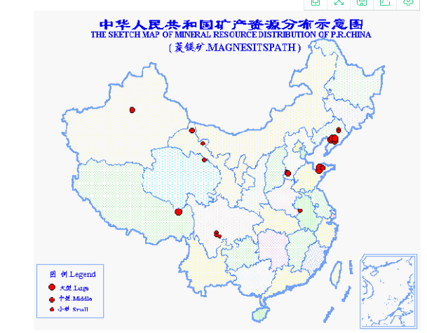
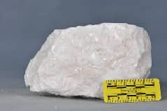
1.Composition and Properties of Magnesium Phosphate Cementitious Materials
Magnesium oxide (MgO)–alkaline component
MgO is primarily prepared through two major pathways: the dry conversion method (calcining magnesite) and the wet conversion method (extraction using magnesium-containing brine or seawater).
baudisserite
The most dominant magnesium
resource currently
Magnesium-bearing dolomite
CaO is difficult to separate
MgO
Main sources
Magnesium salts from Yanshu Lake
—Data source: National Mineral Reserves Database
High energy consumption
As of 2023, Chinas proven magnesite reserves stood at 3.642 billion tons, ranking first in the world and accounting for approximately 28.85% of global base reserves.
seawater

Slide 6
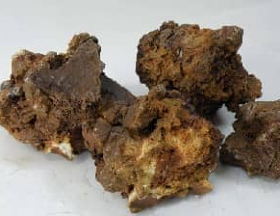
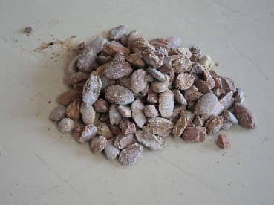
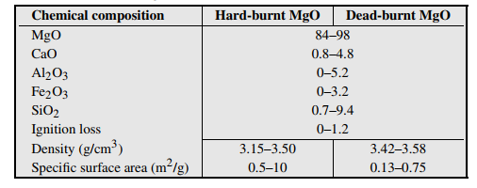
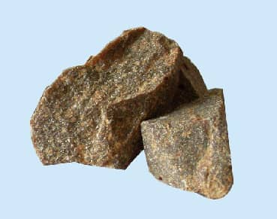
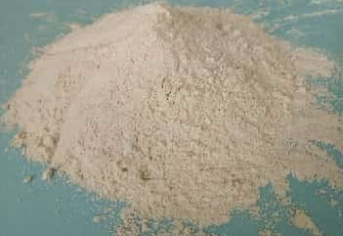
1.Composition and Properties of Magnesium Phosphate Cementitious Materials
Classification and Properties of Magnesium Oxide
Magnesium
oxide
content
Såintered magnesia: MgO content 84%-93%
Medium-grade magnesia: MgO content 94%,95%
High-purity magnesia sand: MgO content ≥97%
Electrolytic magnesia sand: MgO content ≥98%
Calcination temperature of magnesium oxide
Lightly calcined MgO: 700-1000 °C
Medium-burning MgO: 1000-1500 °C
Dead fire MgO: 1500-2000 °C
reburned magnesia sand
Medium-grade/high-purity magnesia sand
Chemical Composition and Physical Properties of Typical Reburned and Dead-burned MgO Samples
fused magnesite
MgO powder

Slide 7
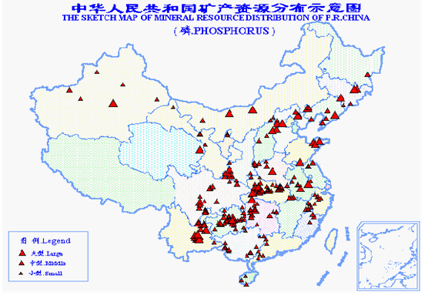
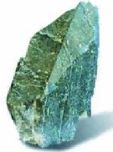
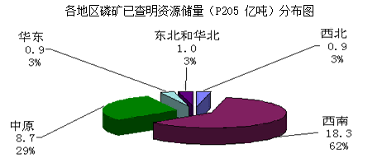
1.Composition and Properties of Magnesium Phosphate Cementitious Materials
Phosphate-acid component
Phosphate is mainly extracted from natural phosphate ores by chemical methods.
apatite
The main phosphorus-containing mineral
3Ca₃(PO₄)₂·CaR₂ (where R = F, Cl, OH, etc.)
Strontium phosphotungsten aluminum phosphate
SrAl 3 (PO 4 ) 2 ( OH ) 5 · H 2 O
—Data source: National Mineral Reserves Database
guano
MgNH 4 PO 4· 6H 2 O
Latheryite
Fe 3 (PO4) 2· 8H 2 O

Slide 8
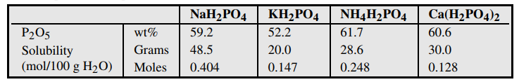
1.Composition and Properties of Magnesium Phosphate Cementitious Materials
Comparison of Basic Properties of Phosphates
Other phosphates
Na 2 HPO 4·12H 2 O
K 2 HPO 4·3H 2 O
AlH 3 (PO 4 ) 2·H 2 O
Mg(H 2 PO 4 ) 2·H 2 O
(NH 4 ) 2 HPO 4
pH
1 wt% solution
4.2-4.6
4.6
4.5
The dihydrogen salt is acidic, while the monohydrogen salt is alkaline. The primary compounds used are ammonium dihydrogen phosphate and potassium dihydrogen phosphate.
NH4 salts exhibit moderate solubility, with the NH4 system demonstrating significant exothermicity and high early strength. However, poor control may lead to NH3 release, making it generally recommended for outdoor engineering applications.
K hydrochloride exhibits low acidity and solubility, making it currently more favored, but its cost is relatively high and the early strength of the K system is relatively low.
Sodium salt has high solubility, and the products of the sodium system are amorphous with significant shrinkage.
Composite phosphates such as NH4-K, NH4-Na, and K-Na are used in formulation.

Slide 9
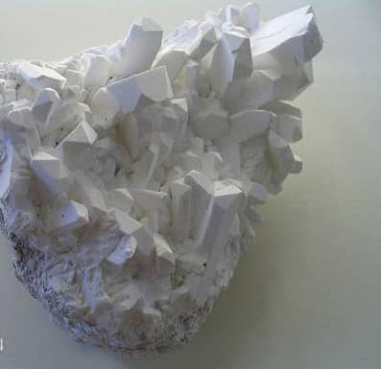
1.Composition and Properties of Magnesium Phosphate Cementitious Materials
Delayed-release component
Comparison of Basic Properties of Retarders
retarder | sodium tripolyphosphate | boric acid | Deca-hydrate borax
solubility /g | 20.0 | 4.87 | 2.01
pH (1 wt% solution) | 9.7 | ~5 | 9.0-9.6
borate mineral
Sodium tripolyphosphate: Na5P3O10 (STPP), exhibits poor retardation effect due to low solubility in acidic environments.
Boric acid: H3BO3, exhibits better retardation effects on potassium salt systems compared to ammonium salt systems.
Borax: Na2B4O7·10H2O or Na2B4O7·5H2O, exhibits endothermic dissolution, improves slurry fluidity, and demonstrates favorable retardation effects.
Borax + Boric acid

Slide 10
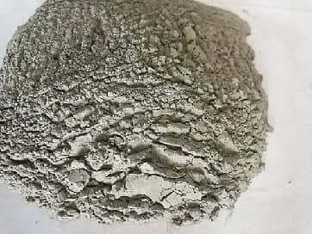
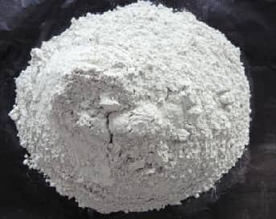
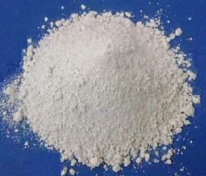
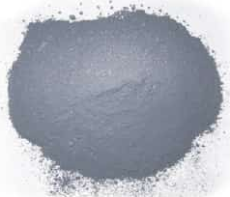
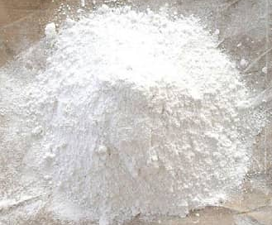
1.Composition and Properties of Magnesium Phosphate Cementitious Materials
Adhesive gel component or filler
flyash FA
Grinding of Blast
Furnace Slag GFBS
metakaolin MK
silica fume SF
wollastonite in powder
WS
Type: MPC demonstrates high adaptability to auxiliary cementitious components. Currently, fly ash is the most commonly used, while others such as finely ground blast furnace slag, kaolinite, limestone powder, steel slag, silica fume, and waste incineration ash can also be utilized in MPC preparation.
Effects and Impacts: It exhibits cost reduction, color modification, and decreased hydration heat release. Depending on factors such as the type of auxiliary cementitious components, chemical composition, particle morphology, and fineness, it can also demonstrate morphological effects, micro-aggregate effects, and potential chemical activity, effectively improving MPC fluidity, strength, and durability.
Addition method: Partial substitution of cementitious materials (considered as fillers) or partial substitution of MgO (considering the potential chemical reaction between phosphates and silica-alumina glass phases)
Dosage: Dependent on the type, fineness, and chemical composition of auxiliary cementitious components, as well as the reference mix ratio and intended purpose.

Slide 11
1.Composition and Properties of Magnesium Phosphate Cementitious Materials
Basic parameters describing the composition of magnesium phosphate cementitious materials
M―MgO
P― phosphate
B-boric acid (salt)
M/P value (or P/M value)
The ratio between phosphate and magnesium oxide can be expressed as a weight ratio or molar ratio.
MgO + NH 4 H 2 PO 4 + 5H 2O = MgNH 4 PO 4·6H 2 O
Relative atomic mass 40 115
When the molar ratio M/P=1/1, the mass ratio M/P is approximately 40/115, or 1/2.9.
MgO + KH 2 PO 4 + 5H 2O = MgKPO 4·6H 2 O
Relative atomic mass 40 136
When the molar ratio M/P=1/1, the mass ratio M/P is approximately 40/136, or 1/3.4.
The M/P molar ratio is approximately three times the molar mass ratio, indicating a significant difference. The mass ratio may be more convenient for practical applications!
The B/M value refers to the dosage of retarder (boric acid/salt), generally calculated based on the weight of magnesium oxide.
W/C value – Ratio of water to cementitious materials (M+P+B)

Slide 12
1.Composition and Properties of Magnesium Phosphate Cementitious Materials
Phosphate magnesium cementitious materials possess excellent properties combining those of cement and ceramics, hence they are also referred to as chemically bonded phosphates ceramics.
Good environmental adaptability
(Severe cold and high temperature)
Ultrafast condensation
(Hardening within minutes)
Ultra-high early strength
(1 hour> 40 MPa)
Exhibits excellent adhesion properties with concrete and steel
Function
Characteristic
Good liquidity
（ self-leveling ）
Excellent reinforcement performance
(Prevention of steel bar corrosion)
Good volume stability
(Systolic value <0.02%)
Excellent durability performance
(Low permeability)

Slide 13
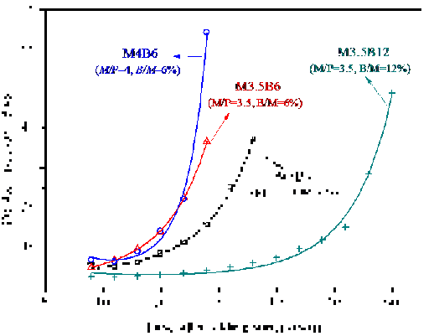
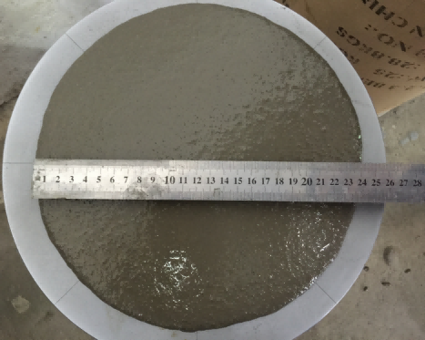
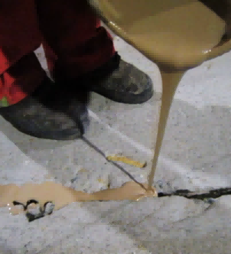
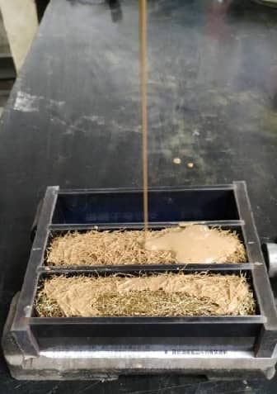
1.Composition and Properties of Magnesium Phosphate Cementitious Materials
Fresh Mixing Performance
Reinforced sleeve grouting (prefabricated buildings)
Conventional grouting (self-compacting concrete structure)
Fracture Grouting (Concrete Structures/Highways)
Pore grouting (prestressed anchor cable)
MPC exhibits excellent fluidity.
Low water consumption, no need for water reducer, with a minimum water-to-binder ratio below 0.10
Exhibits excellent water retention and maintains high fluidity without water exudation
However, due to rapid setting and hardening, the fluidity almost disappears instantaneously near the onset of solidification.

Slide 14
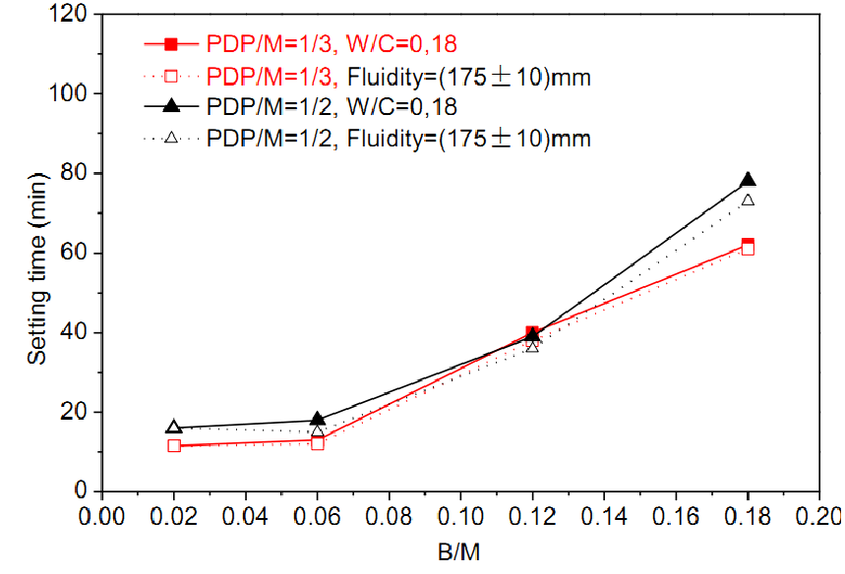
1.Composition and Properties of Magnesium Phosphate Cementitious Materials
Fresh Mixing Performance
MPC exhibits rapid setting and hardening characteristics.
Condensation time is easily influenced by magnesium oxide activity, mixing ratio, ambient temperature, and pouring dimensions.
The adjustment is generally within the range of 3-90 minutes. Excessively short coagulation time results in operational inconvenience during construction, while prolonged duration adversely affects other performance characteristics.
The interval between initial coagulation and final coagulation is short, and the initial coagulation time is generally used as the coagulation time.
Effect of Borax Content (B/M=2%,6%,12% and 18%) on Setting Time of MKPC Slurry

Slide 15
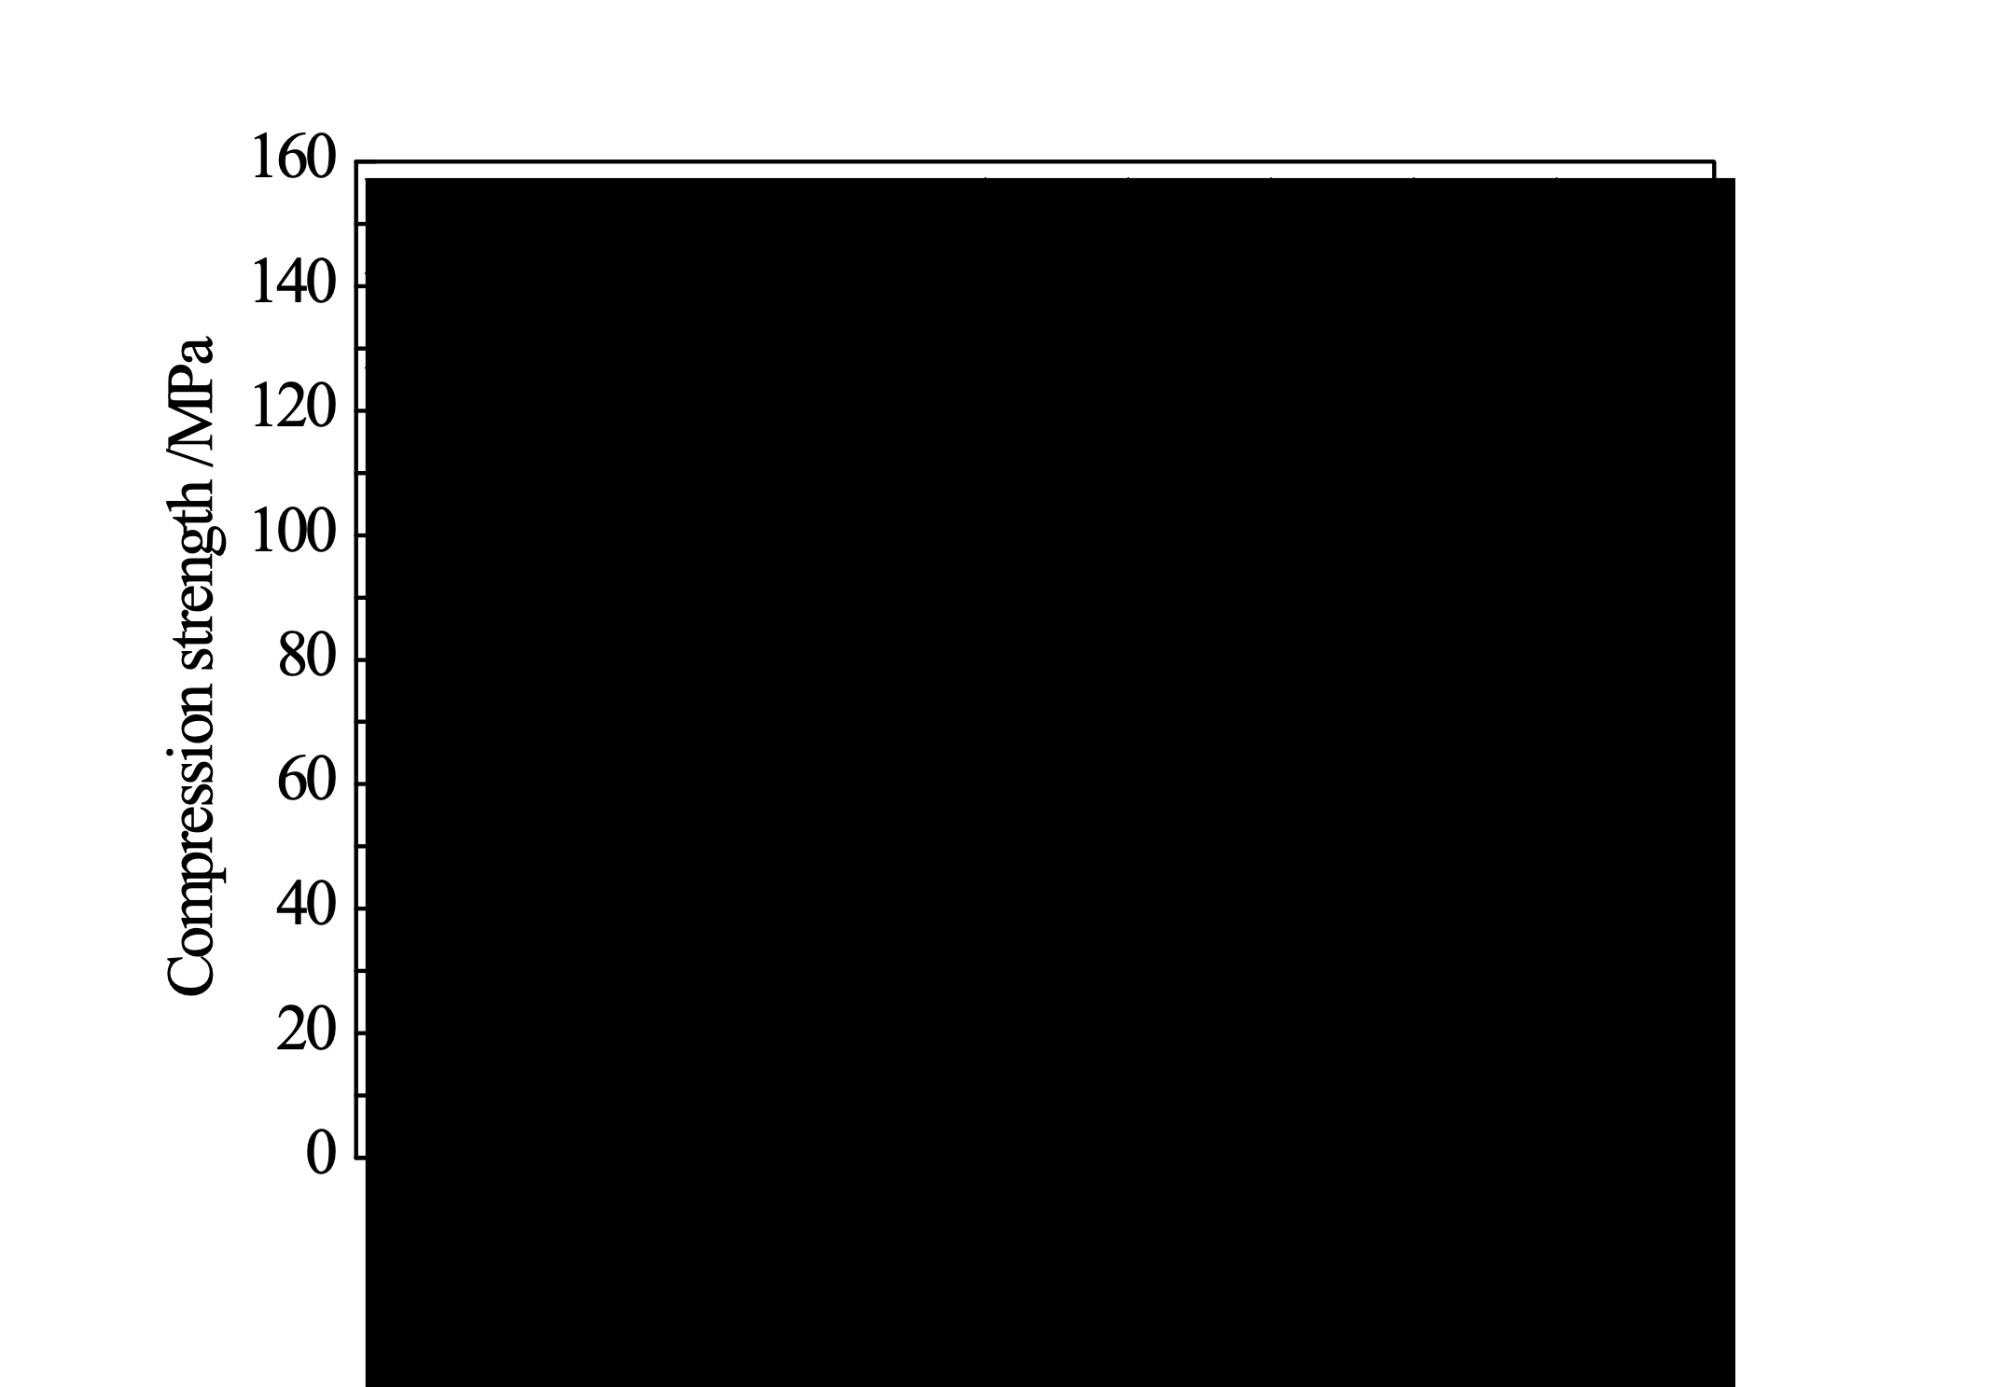
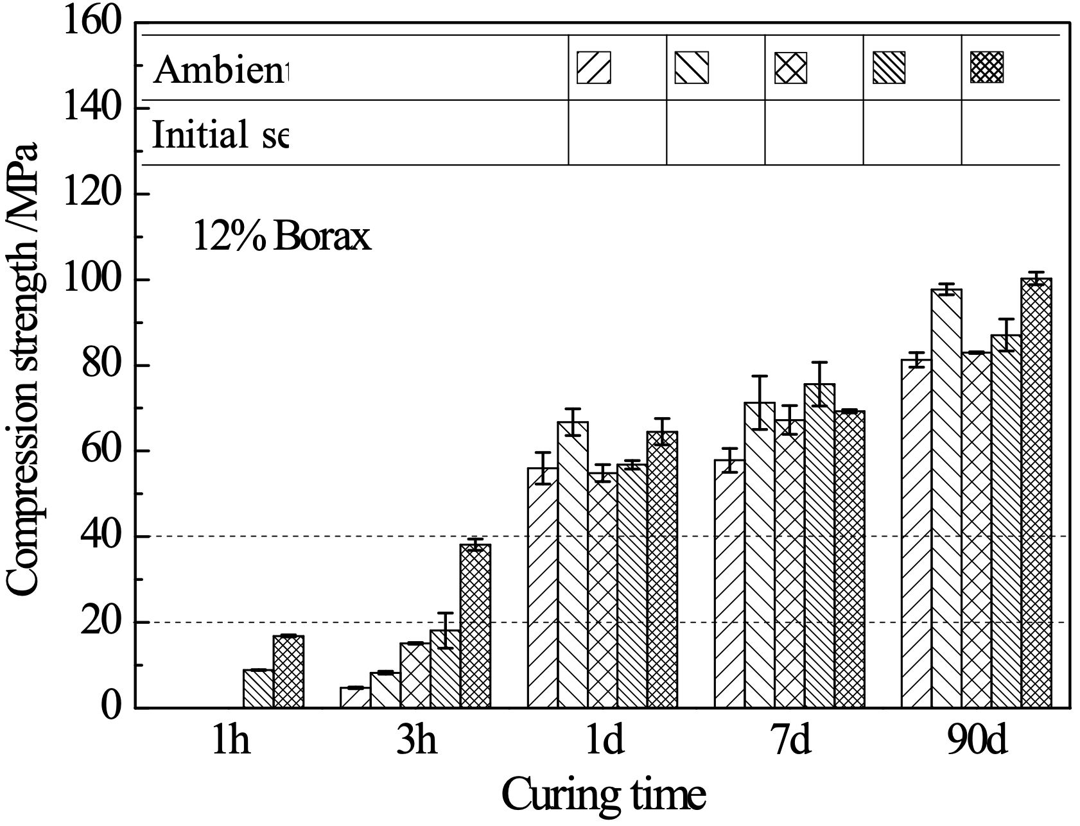
1.Composition and Properties of Magnesium Phosphate Cementitious Materials
Strength development
Effect of retarder dosage and ambient temperature
30MPa
(a) B/M=6%
MAPC (M/P=4, w/b=0.12)
(a) B/M=12%
Matching retarder dosage with ambient temperature to regulate the setting time, hydration temperature rise, and early strength of MPC

Slide 16
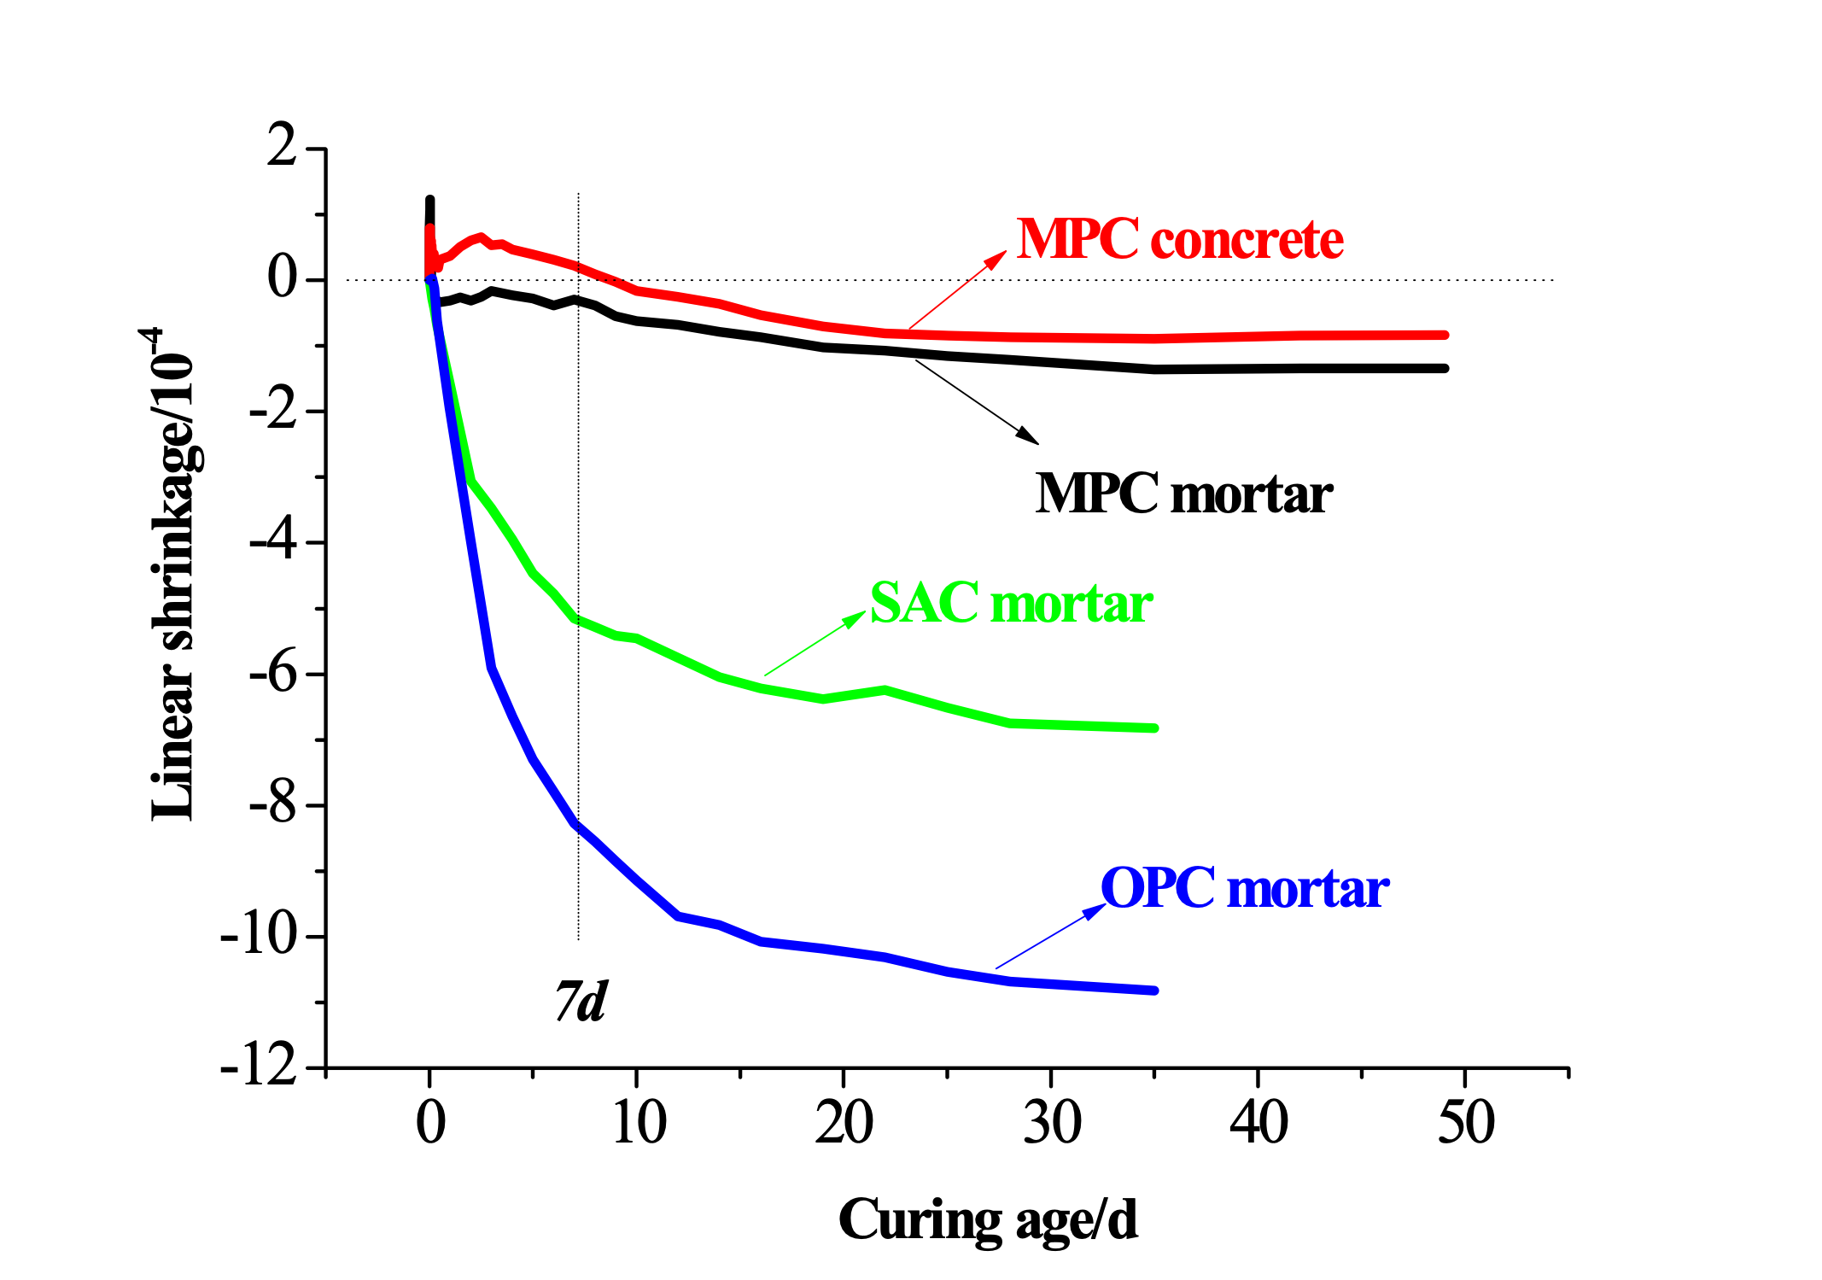
1.Composition and Properties of Magnesium Phosphate Cementitious Materials
Cubic deformation
Comparison of drying shrinkage rates between MPC mortar and other cement mortars
Ultra-low contraction in the early stage (before 12 hours)
even slight expansion
late-stage shrinkage reduction
Low overall deformation

Slide 17
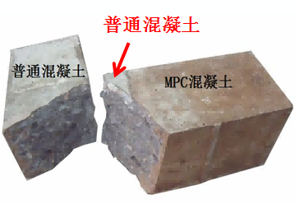
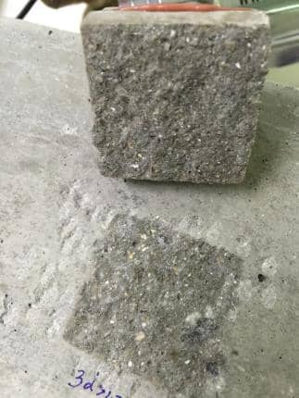
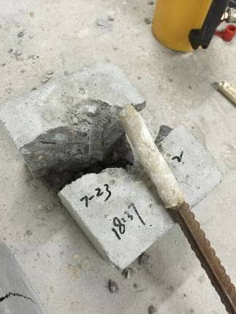
1.Composition and Properties of Magnesium Phosphate Cementitious Materials
Interface adhesion performance
Matrix destruction
The matrix concrete is adhered and damaged
Strongly bonded with concrete, stone, steel, and wood;
Interface flexural strength (for C40 concrete): 3d> 5MPa;
Positive bond strength (for C40 concrete): 3 days> 2 MPa;
Bonding strength between steel bars and C30 concrete under constrained pull-out condition: 6h> 8.5 MPa
1-10mm thin-layer bonding
Reinforcement bar and bolt planting

Slide 18
1.Composition and Properties of Magnesium Phosphate Cementitious Materials
Excellent wear resistance
Comparison of Wear Resistance Between MPC and Other Materials
Material types | MPC mortar | MPC concrete | OPC concrete
compression strength /MPa | 69.8 | 57.8 | 56.9
abrasion resistance IA | 7.12 | 7.87 | 3.92
Wear rate/kg/m² | 1.95 | 1.31 | 3.0~3.5
MPC concrete exhibits wear resistance up to twice that of ordinary concrete, making it suitable for rapid repair of high-wear or damaged areas such as concrete pavements, bridge decks, garage floors, airport runways, and aprons.

Slide 19
1.Composition and Properties of Magnesium Phosphate Cementitious Materials
Durability
salt corrosion resistance
Strength Development of MPC Mortar Immersed in Different Salt Solutions
Type of salt solution | rupture strength /MPa |  |  | compression strength /MPa
 | 30d | 70d | 210d | 30d | 70d | 210d
10% Na 2 SO 4 | 7.75 | 7.85 | 8.51 | 67.5 | 65.1 | 66.1
10% MgSO 4 | 7.85 | 8.24 | 8.65 | 70.1 | 72.6 | 74.0
Simulated seawater | 8.05 | 8.44 | 8.74 | 68.3 | 69.4 | 69.0
Resistant to corrosion by sulfates and chlorides
Suitable for Concrete Defect Repair in Saline Soil and Marine Environments

Slide 20
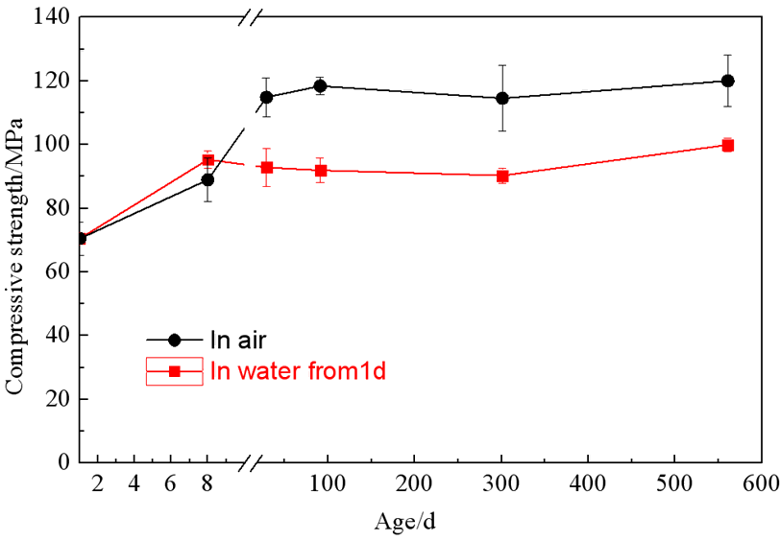
1.Composition and Properties of Magnesium Phosphate Cementitious Materials
Durability
resistance to water
Cured in air
≈15%
Cured in water
Factors affecting water resistance:
Incomplete dissolution of phosphate
Hydrate product dissolution
Volume expansion caused by hydration product transformation
……
Sample size: 25×25×25 mm³
Long-term strength development of a typical MPC paste (weight M/P = 4, B/M = 6 %, w/b = 0.125) under water curing

Slide 21
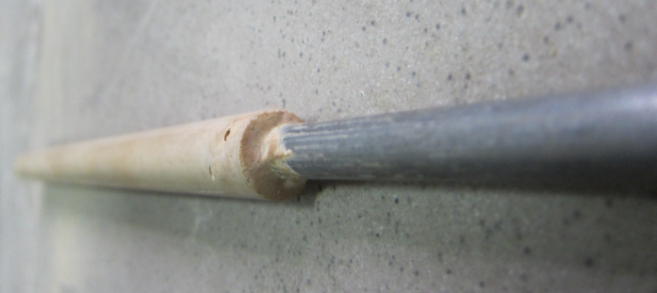
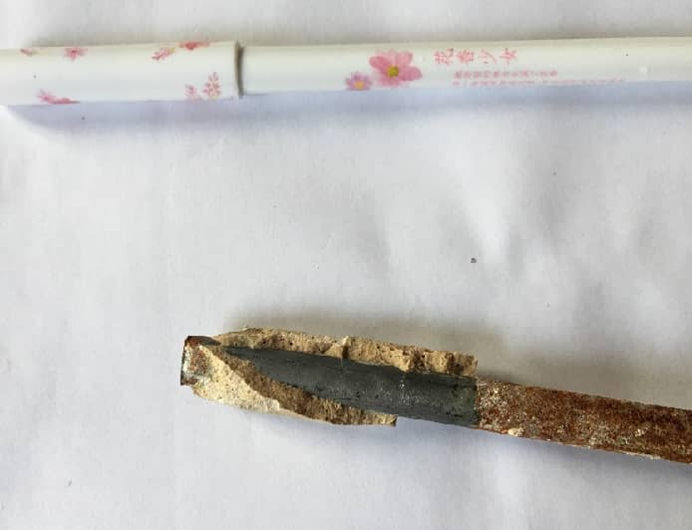
1.Composition and Properties of Magnesium Phosphate Cementitious Materials
Reinforcement performance
It exhibits extremely strong bonding with metals such as steel;
The MPC has a small shrinkage rate, allowing the formation of a reinforcement cover even in thin layers.
Compared with ordinary Portland cement, it exhibits distinct mechanisms for steel protection.
The protection of metals such as steel involves both physical and chemical aspects, with chemical protection demonstrating more pronounced efficacy.
Open observation after 2 years

Slide 22
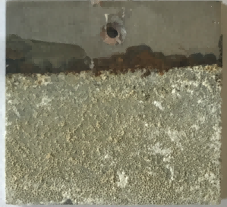
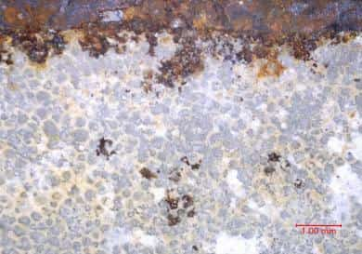
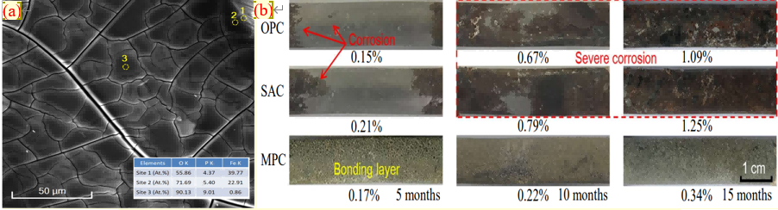
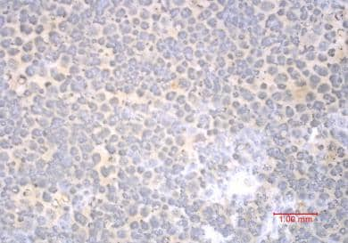
1.Composition and Properties of Magnesium Phosphate Cementitious Materials
Reinforcement performance
MPC demonstrates superior corrosion resistance to steel reinforcement compared to OPC and SAC.
After corrosion initiation, the development of corrosion can still be inhibited to some extent.
Compared to epoxy resin sealing, it offers additional advantages.
(a)
MPC system ：
Thin layer thickness: 5 mm
Maintenance period: 7 days
Acceleration system:
4d drying at 40°C + 3d immersion in 3.5% NaCl solution
Loop count: 50
Epoxy resin
uniform corrosion
(a)
pitting
Inhibit !
(b)
(b)
Most are in good protective condition
MAPC
mpc binder layer (1 mm)
Corrosion Development on Electrode Surface After Multiple Wet-Dry Cycles

Slide 23
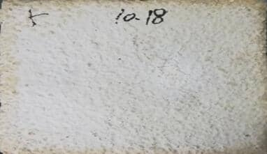
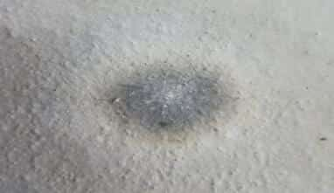
1.Composition and Properties of Magnesium Phosphate Cementitious Materials
Fire protecting performance
Appearance after fire resistance test (1h)
Fireproof coating test
Steel plate
150 mm
MPC paint-coat
3 mm
8 mm
(~1000 o C)
70 mm
Fireproof coating
Commercial paint
alcohol blast burner
MPC fireproof coating mix ratio:
M/P = 3 (mass ratio), B/M = 0.1
Water/cementitious material = 0.2
Expanded perlite/cementitious material = 0 / 10%

Slide 24

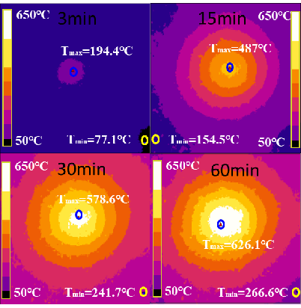
1.Composition and Properties of Magnesium Phosphate Cementitious Materials
Fire protecting performance
Effect of Temperature Rise on Barrier Isolation
Infrared thermal imager
550 ℃
Temperature variation chart of the back surface of steel plate with temperature
MPC coatings exhibit excellent fire resistance potential
Screenshot of measurement results from an infrared thermal imager

Slide 25
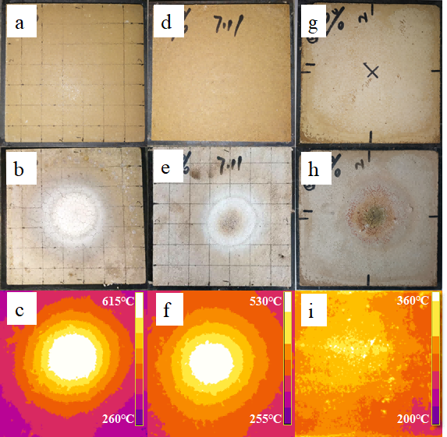
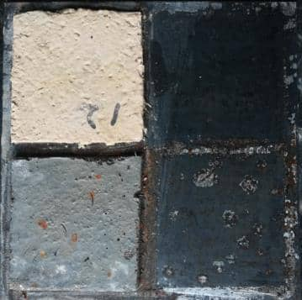
1.Composition and Properties of Magnesium Phosphate Cementitious Materials
Fire protecting performance
The linear shrinkage of magnesium phosphate cement coating at high temperature (1100°C) is 0.6%.
Each cycle: soak in water for 18 hours (22±2°C)
Drying for 6 hours (50 ±2°C)
Dual effect of fireproofing and anti-corrosion
MPC paint-coat
non corroding
0% EV
30% EV
60% EV
Enhancement of High-Temperature Crack Resistance
Commercial paint
rustiness
The temperature distribution is uniform, with the highest temperature decreasing.
Appearance after 7 dry-wet cycles
MPC coating holds promise for integrated fireproofing and anti-corrosion functionality

Slide 26
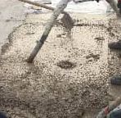


2.Engineering Applications of Magnesium Phosphate Cementitious Materials
Key technical aspects of MPC for ultra-rapid repair reinforcement
Material application form: It can be used in the form of MPC net slurry, mortar, or concrete, depending on the specific application site.
Condensation time control: For larger volumes, control for over 25 minutes; for smaller applications, 10-20 minutes is recommended.
Stirring method: Manual mixing, handheld mixer, or mechanical mixer can be used, depending on construction site conditions and material requirements.
Pouring: Pure slurry and mortar can be directly poured for filling, with concrete supplemented by vibration.
Maintenance: Minimize exposure to rainwater before hardening, and no maintenance is required after hardening.
Strength determination: After hardening, rebound elasticity testing is performed, typically exceeding 30 MPa within 1 hour. Strength development is related to ambient temperature and pouring volume.
Put into service: It can be put into use after meeting the strength requirements, typically within 0.5-3 hours post-construction.
Pure slurry
concrete
Handheld mixer
machine mixing

Slide 27









2.Engineering Applications of Magnesium Phosphate Cementitious Materials
Magnesium phosphate mortar has been applied in road repair projects in high-altitude and cold regions such as Qinghai and Inner Mongolia.
Rapid Repair of Airport Runway and Landing Pad
Jiangbei Airport, Kunming Changshui Airport
Rapid Repair of Bridge Expansion Joint/Cold Joint
Rapid Repair and Reinforcement of
Concrete Structures
Rapid Repair of Tunnel/
Highway Pavement
Thin-layer floor covering
Equipment infrastructure emergency
repair and reinforcement
Grouting anchoring/Reinforcement anchoring
Negative Temperature/Low
Temperature Repair

Slide 28











2.Engineering Applications of Magnesium Phosphate Cementitious Materials
Install steel mesh
formwork
top grouting
Demolding in 2 hours with good apparent quality
self-leveling
Grouting/grouting process: Early strength and excellent fluidity, used for slope stabilization, tunnel lining, or shield segment protection
Pore
Stirring, grouting
drain off water
ichor
Three-day anchorage force test passed

Slide 29







2.Engineering Applications of Magnesium Phosphate Cementitious Materials
FA enhances mobility
number | MPC (%) | FA (%) | Water-to-cement ratio | Glass-cement ratio | divergence （mm） | Injection depth (mm)
1 | 100 | 0 | 0.18 | 1:0.5 | 275 | 163
2 | 95 | 5 | 0.24 | 1:0.5 | 335 | 200
3 | 90 | 10 | 0.24 | 1:0.5 | 340 | 200
4 | 80 | 20 | 0.24 | 1:0.5 | 345 | 200
5 | 70 | 30 | 0.24 | 1:0.5 | 320 | 200
200mm
Pretreated coarse aggregate grouting: Utilizing excellent fluidity and bonding properties for road expansion joints, airport runways, and pavement pothole repairs
Clean the area to be repaired
Embedded coarse aggregate, poured mortar
Surface finishing and covering maintenance
In service for 2 hours

Slide 30








2.Engineering Applications of Magnesium Phosphate Cementitious Materials
Matrix concrete
bonding failure
Pulling bond test
Construction of 1cm thin floor coating layer
Ultra-thin layer coating: Utilizing excellent adhesion properties, it is applied as a surface layer for garage floors and light-duty road surfaces.
Surface milling and cleaning of concrete
Slurry Mixing
Paving and Surfacing
In service for 2 hours

Slide 31









2.Engineering Applications of Magnesium Phosphate Cementitious Materials
Planting and anchoring technique: Utilizing adhesive properties
Guangzhou Ring Expressway
anti
Reinforcement of Crash Wall on Guangzhou Ring Expressway
Guangzhou Poly
• Financial City
Guangzhou Ring Expressway
pre-installed anchorage package
soundproof wall
MPC inorganic anchoring agent was employed for reinforcement bar anchoring.
The on-site pull-out test conducted within 3-6 hours demonstrated that the anchoring force met the design requirements.

Slide 32





2.Engineering Applications of Magnesium Phosphate Cementitious Materials
Anti-corrosion Coating for Pipelines in a Factory in Guizhou
MPC Mortar Repair of Bridge Concrete Columns
Application of MPC Anti-corrosion and Fireproof Coating
Improving Anti-Slip Performance Using Lignin Fiber Reinforcement
No issues such as protective layer detachment or steel pipe corrosion were observed after 6 months of protective treatment.
Self-compacting MPC mortar is employed for rapid repair of concrete bridge columns. The mortar requires no vibration and achieves self-compaction, allowing formwork removal within 20–30 minutes after pouring.

Slide 33
3.Series of Products of Magnesium Phosphate Cementitious Materials
1 Magnesium phosphate repair mortar
Application scenarios: ® airport runways, concrete pavements, and high-speed rail sleepers/rails
Rapid Repair Materials for Cement Concrete in Highway Engineering Part 1: Cement-based Repair Materials (JTT1211.1-2018)
Technical specifications: When concrete pavements are open to traffic, the compressive strength of repair materials must be no less than 30MPa, and the 1-day bond strength with C40 concrete must be no less than 1.2MPa.
Technical Guidelines for Maintenance of Cement Concrete Pavement in Civil Airports (MH/T-2024)
Technical specifications: Airport pavement repair requirements include: 3-hour compressive strength of no less than 30MPa, flexural strength ≥ 4.0MPa, and flexural bond strength ≥ 1.0MPa; 3-day compressive strength of no less than 45MPa, flexural strength ≥ 5.0MPa, and flexural bond strength ≥ 4.0MPa (no bond strength requirements for fast-hard Portland cement concrete repair materials).
The MPC mortar / concrete exhibits a 3-hour compressive strength exceeding 30MPa and flexural strength reaching 4.5MPa, with a 3-hour bond strength of over 1.2MPa when paired with C40 concrete (achievable even in extreme cold environments ranging from -20 to -10 degrees Celsius without requiring thermal insulation curing).

Slide 34

3.Series of Products of Magnesium Phosphate Cementitious Materials
Technical Guidelines for Maintenance of Cement Concrete Pavement in Civil Airports (MH/T-2024)

Slide 35
3.Series of Magnesium Phosphate Cementitious Materials Products
Main Technical Performance Indicators of Magnesium Phosphate Repair Mortar
time of setting | mortar expansion degree | drying shrinkage | 3D bonding strength
15~30min | >200mm | <0.05% | >2.5MPa
2-hour compressive strength | 2-hour flexural strength | 1-day compressive strength | 1-day flexural strength
>20MPa | >3.5MPa | >40MPa | >6.0MPa
7-day compressive strength | 7-day flexural strength | 7d splitting tensile strength | 7-day direct tensile strength
>80MPa | >10.0MPa | >5.0MPa | >4.0MPa
The bond strength refers to the tensile bond strength between magnesium phosphate repair mortar and concrete.

Slide 36
3.Series of Magnesium Phosphate Cementitious Materials Products
2 Magnesium phosphate grouting material
Application scenarios: ® rock slopes, shield segments, tunnel linings, and foundation works
Technical Specification for Application of Cement-based Grouting Materials (GB/T 50448—2015)
Table 4.1.1 Technical Specifications:
Conical flow velocity: Class I has no specific indicator, Class II ≥ 340 mm, and Class III ≥ 290 mm.
Compressive strength: Class I – 1 day ≥ 15 MPa, 3 days ≥ 30 MPa, 28 days ≥ 50 MPa;
Class II and Class III—1d ≥ 20MPa, 3d ≥ 40MPa, 28d ≥ 60MPa;
Chloride ion content <0.1%
The MPC grouting material exhibits a flowability of ≥300mm, with compressive strength exceeding 30MPa at 3 hours, 50MPa at 1 day, and 70MPa at 28 days. The MPC grouting material is free of chloride ions and demonstrates excellent corrosion resistance for steel bars/prestressed tendons.

Slide 37

3.Series of Magnesium Phosphate Cementitious Materials Products
2 Magnesium phosphate grouting material
Application scenarios: ® rock slopes, shield segments, tunnel linings, and foundation works
Technical Specifications for Structural Repair and Reinforcement Techniques of Subway Shield Tunnel (Group Standard):
MPC grouting material is used for tunnel lining and shield segment repair, achieving a compressive strength of 5MPa within 1 hour, 10MPa within 3 hours, and exceeding 20MPa after 1 day (MPC grouting equipment).

Slide 38



3.Series of Products of Magnesium Phosphate Cementitious Materials
2 Magnesium phosphate grouting material
Application scenarios: ® rock slopes, shield segments, tunnel linings, and foundation works
Grouting Reinforcement of Foundation and Large Equipment Foundations
MPC grouting material is designed for rapid repair of large equipment foundations, achieving a compressive strength of ≥30MPa within 1 hour and ≥40MPa within 1 day. This ensures swift restoration of equipment functionality, with economic benefits far exceeding the construction costs of grouting materials.

Slide 39


3.Series of Magnesium Phosphate Cementitious Materials Products
3 Magnesium Phosphate Protective Material
Application scenarios: ® steel structures, concrete structures, chemical steel pipelines, and storage tanks
Anti-corrosion of Steel Structures and Concrete Structures
Strong Acid and Strong Base Workshop
MPC protective materials are used for corrosion protection of chemical steel thermal pipelines (at high temperatures), with a tensile bond strength to steel ≥ 1.0 MPa. They exhibit high-temperature resistance and superior anti-corrosion performance compared to epoxy resin coatings, enabling integrated corrosion protection, fire resistance, and thermal insulation for petroleum storage tanks.

Slide 40




3.Series of Magnesium Phosphate Cementitious Materials Products
4 Magnesium Phosphate Self-Leveling Mortar
Application scenarios: ® parking, docks
Garage floor and heavy-duty workshop floor
MPC self-leveling mortar is used for garage floors, exhibiting excellent wear resistance, dust-free performance, crack resistance, and superior adhesion to base concrete (with bond strength exceeding 2.0 MPa).

Slide 41

4.Application Prospects of Phosphate Magnesium Cementitious Materials Product Series

Slide 42
4.Application Prospects of Phosphate Magnesium Cementitious Materials Product Series
(1) Highway Transportation Sector
According to the Ministry of Transports "14th Five-Year Plan for Highway Maintenance Management Development Outline", Chinas total highway mileage reached 5.28 million kilometers by April 2022. During the 13th Five-Year Plan period, the nation invested 1.29 trillion yuan in maintenance funds, implementing preventive maintenance on 1.356 million kilometers, repair maintenance on 1.652 million kilometers, highway safety life protection projects on 1.16 million kilometers, and renovating 58,000 hazardous bridges. It is projected that during the 14th Five-Year Plan period, cumulative maintenance investments nationwide will reach 1.5 trillion yuan, with pavement repair and maintenance funds expected to amount to 500 billion yuan.
The use of magnesium phosphate repair materials facilitates improved efficiency in routine highway maintenance and repair operations, significantly reducing road closure duration and minimizing adverse impacts on traffic flow. It enables direct utilization of discarded road pavement materials, promoting the recycling and reuse of waste pavement materials, thereby achieving green construction practices for road maintenance and rapid repairs.

Slide 43
4.Application Prospects of Phosphate Magnesium Cementitious Materials Product Series
(2) Airport Construction
Chinas civil aviation transport airports increased from 180 in 2011 to 248 in 2021, with an average annual growth rate of 6.8. Additionally, the number of general transport airports reached 340 by 2020. According to the "14th Five-Year Plan for Civil Aviation Development," Chinas civil aviation transport airports are expected to exceed 270 by 2025, marking an increase of 22 from 2021. The "National Integrated Three-Dimensional Transportation Network Plan Outline" proposes that by 2035, the country will have approximately 400 civil aviation airports and establish around 40 regional aviation hubs.
The daily maintenance and rapid repair of airport runways and aprons demand materials with exceptional technical performance. Conventional repair materials struggle to meet the stringent requirements for early strength and wear resistance during the extremely short construction window periods for runway and apron restoration. Chinas annual investment in airport runway and apron repairs is projected to reach 8 billion yuan. Magnesium phosphate-based repair materials effectively satisfy rapid repair requirements. These phosphoric acid repair mortars have been successfully implemented in the pavement restoration project at Chongqing Jiangbei International Airport and have been incorporated into the Technical Guidelines for Cement Concrete Pavement Maintenance in Civil Airports, demonstrating low resistance to widespread adoption.

Slide 44
4.Application Prospects of Phosphate Magnesium Cementitious Materials Product Series
(3) Building Construction
Chinas existing urban building area exceeds 60 billion square meters, with over 20 billion square meters of structures aged more than 30 years, marking the onset of maintenance phases for numerous buildings. Meanwhile, annual housing completions have remained stable at approximately 4 billion square meters for consecutive years (Figure 2.1). Predominantly constructed with concrete frameworks, existing buildings require over 1 million tons of inorganic binders annually for construction and structural reinforcement. Additionally, the consumption of inorganic adhesives for structural protection and maintenance is projected to surpass 1 million tons per year.
In the field of inorganic repair materials, current products primarily utilize general Portland cement and sulfoaluminate cement as cementitious materials for preparation. Although numerous manufacturers are involved, production scales remain relatively small with low market concentration and no significant industry monopolization, creating substantial potential for the subsequent promotion of magnesium phosphate cement product series.

Slide 45

4.Application Prospects of Phosphate Magnesium Cementitious Materials Product Series
(4) Construction and Maintenance of Subway and Underground Engineering
Shield segment leakage and subway station maintenance face challenges due to short operational windows. The use of magnesium phosphate grouting materials effectively addresses the difficulties and inefficiencies in repairing tunnel segment leaks during construction. Taking Chongqing Metro as an example, with maintenance costs of 1.4 million yuan per kilometer and annual expenditure reaching 700 million yuan, there remains significant potential for implementing magnesium phosphate grouting solutions.
Magnesium phosphate cementitious materials can also be used for seepage prevention and rapid repair in underground engineering projects.

Slide 46
4.Application Prospects of Phosphate Magnesium Cementitious Materials Product Series
(5) Military Engineering
Emergency repairs and construction of airport runways in high-altitude cold regions and polar areas, including ® runways and helicopter landing pads
Port Terminals and Coastal Concrete Structures: Protection and Restoration ® Concrete Structure Repair and Anti-corrosion
Technical Advantages: High early strength with compressive strength reaching 30MPa within 2 hours in severe cold environments and exceeding 60MPa after 7 days. Mechanical properties continue to improve upon temperature recovery, potentially exceeding 80MPa. Extended storage duration: Two-component materials maintain mechanical integrity when sealed for 1 year, with performance degradation of approximately 10% after 5 years of sealed storage. Simple and efficient construction methods include continuous mixing via concrete mixer trucks or spray application techniques. Superior corrosion resistance demonstrates excellent seawater erosion resistance and prevents steel reinforcement corrosion.

Slide 47



4.Application Prospects of Phosphate Magnesium Cementitious Materials Product Series
(5) Military Engineering
building blast resistance
Technical Advantages: The magnesium phosphate ultra-high performance concrete (UHPC) is produced through on-site casting. Without curing conditions, it exhibits compressive strength of 80–90 MPa and flexural strength of 20–25 MPa at 6-hour age; compressive strength of 120–130 MPa and flexural strength of 30–35 MPa at 7-day age, with tensile strength exceeding 7 MPa. The elastic modulus reaches 50–60 GPa at 28-day age. Specified compressive strength test specimen dimensions: 100 mm ´100 mm ´100 mm.
The compressive strength test specimen dimensions are: 100mm ×100 mm ×400 mm.
Mobility and coagulation time
compression strength
rupture strength

Slide 48
4.Application Prospects of Phosphate Magnesium Cementitious Materials Product Series
Technical Advantages: Magnesium oxide exhibits high infrared reflectivity and low emissivity, effectively reducing infrared radiation intensity on surfaces to achieve stealth effects. Superior Environmental Resistance: With high melting points and excellent thermal/chemical stability, it maintains performance stability under harsh conditions including high temperatures and humidity. The MPC coating demonstrates outstanding hardness, wear resistance, wind erosion resistance, as well as excellent density and adhesion properties.
(5) Military Engineering
Infrared Stealth Coating
Application fields of magnesium phosphate coatings: These coatings can be utilized for infrared stealth in military equipment to reduce the probability of targets being detected by infrared detection devices. When applied to building exterior walls, magnesium phosphate coatings enable infrared stealth effects while enhancing coating durability and thermal insulation performance. Additionally, magnesium phosphate coatings can be used for surface protection of high-end equipment, improving infrared stealth capabilities, corrosion resistance, and high-temperature performance under harsh environmental conditions.
Application Objective: To develop a multifunctional integrated composite coating combining infrared stealth, radar stealth, and electromagnetic shielding; and to combine carbon-based materials to develop magnesium phosphate coatings capable of self-adaptive adjustment of infrared stealth performance in response to environmental changes.

